Slide 1
Formal Email Writing

Slide 2
Why email writing is important?
It is a less expensive form of communication.
It helps to contact/send information to a large group.
It provides a written record of the communication.
It is an instantaneous form of communication.
It can be used anytime and anywhere.

Slide 3
Features
Automatic reply to messages
The address can be stored or reused anytime
Notification of delivering or not of a message
Facility to send copies of a message to many people
Signatures can be attached
Attachments in the form of files, graphics or sound can be sent.

Slide 4

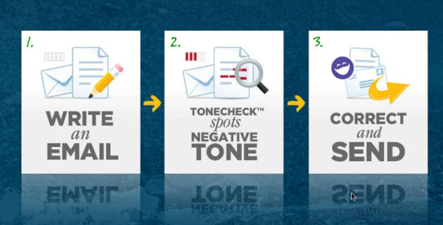
Before writing an email ….
Think about why you are writing
Consider the tone and the way you express yourself

Slide 5
When writing the email …..
1) Subject Line - Concise and specific
Ex: Request for a reference letter
2) Salutation - use the recipient's surname with a courtesy / honorary title
Ex: Dear Dr Smith, Dear Ms Lim
Dear Madam OR Ms , Dear Sir
*if the mail is sent to many
Ex: Dear all

Slide 6
Opening the e-mail: reasons for writing
3) Body Paragraphs
I am writing with reference to...
I am writing with regards to...
I am writing on behalf of...
Following /Further to our (telephone) conversation/meeting on (date) , …..

Slide 7
Request of action:
Please pay your concern regarding this request at your earliest convenience
Please confirm whether the arrangements could be done.
A prompt response would be highly / much appreciated.

Slide 8
Apologizing / giving bad news:
Please accept my apologies for…
I regret to inform you that…
I apologize for any inconvenience this may cause.

Slide 9
when documents are attached :
Please find the attached /enclosed report as per requested.
The report is attached herewith.
Attached herewith is/are
Affixed please find the…

Slide 10
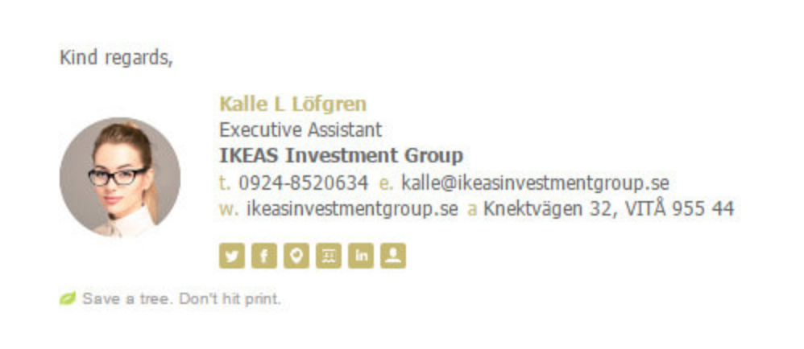
4) Closing
-Choose an appropriate closing.
Ex: Regards / Best regards / Kind regards
Then include your full name, contact information, and title.
*You can use a professional signature.

Slide 11
netiquette
Professionalism counts: the tone and language
Content should be concise, clear, accurate and organized
Check whether the content is explained well and complete.
Reread it before sending

Slide 12
Replying
Do not forget to reply the sender once the mail is received; at least by saying,
Received. Thank you.
OR
Noted with thanks.
Make sure to include the original message in your reply if you have added any recipients.

Slide 13
Select the appropriate words to complete the following mail.
I am writing with (1) connection/reference/regarding to our telephone conversation this morning about your order 7895LG. I must (2) regret/apologize/sorry for the delay in processing this order. I can now confirm that the goods have been shipped and should (3) arrive/reach/deliver you within 10 working days. We have taken special care to make sure that the items are exactly as you requested.
Once again, please (5) take/have/accept our apologies. If you have any further questions, do not (6)stop/fail/hesitate to contact me again.

Slide 14
Group Activity 03- Step 01
Write an email to a business contact to invite them to a meeting or event.
Prepare the situation using the questions below. The information can be real or imaginary.
• What is your company’s business? What products/services do you offer?
• What kind of a meeting/event are you going to organise?
• To whom are you inviting?
• Why would he or she be interested and want to come?
• Does he or she need to prepare or bring anything?
• What are the details? (date, time, place etc.)
• Will lunch or refreshments be provided?
• Do you want him or her to reply by a certain date to confirm his or her participation?

Slide 15

References
https://business.tutsplus.com/articles/how-to-write-a-formal-email--cms-29793
https://learnenglishteens.britishcouncil.org/sites/teens/files/a_more_formal_email_-_exercises.pdf
https://www.thebalancecareers.com/employment-related-email-message-examples-2061898

